Slide 1
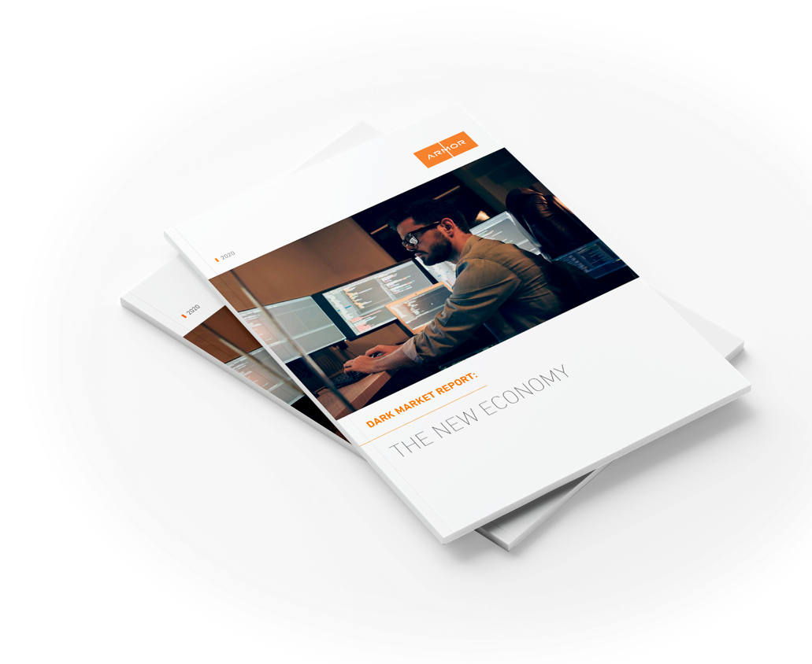
DARK MARKET REPORT 2020: THE NEW ECONOMY
CHRIS HINKLEY
Head of Armor’s Threat Resistance Unit (TRU)
Notes:
Hello, everyone and thank you having me, it is an honor to speak to you.
I’m here to talk about the Dark Web and the marketplaces and forums which make up this illicit underground and why everyone should care what happens there, and offer ideas on how you can protect yourself in what is becoming one of the most important business challenges of the next decade.

Slide 2
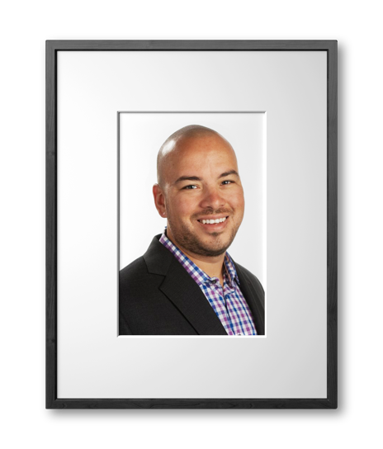
About the speaker
CHRIS HINKLEY
Head of Armor’s Threat Resistance Unit (TRU)
15 years of cybersecurity experience
Certified Information Systems Security Professional (CISSP)
Offensive Security Certified Professional (OSCP)

Slide 3
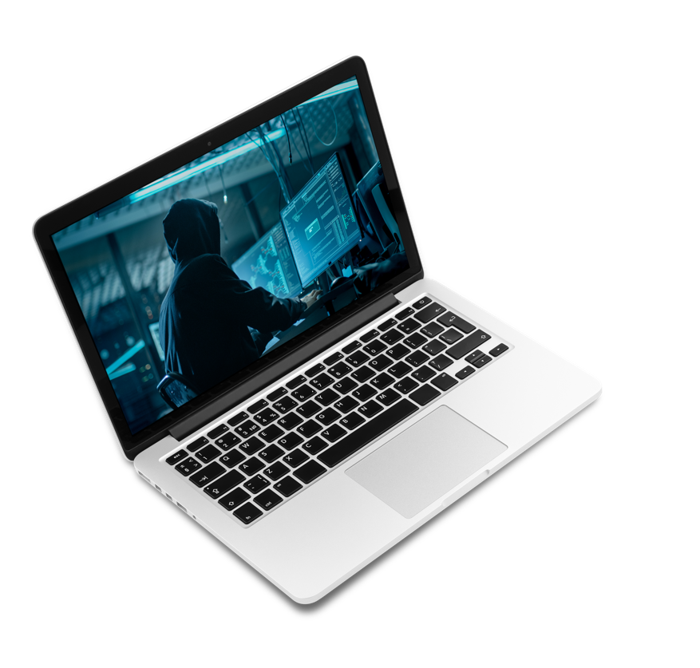
agenda
The Business of the Dark Market
1
Cybercrime-as-a-Service
2
Constant Vigilance
3
Q & A
4
Notes:
Talk about the business of the dark web and why threat intelligence around markets is important.
We will take a look at the different marketplaces and forums our Threat Resistance Unit (TRU) research team is finding on the Dark Web--- the goods and services being bought, sold and traded in this nefarious “Underground.”
Dark Web cybercriminals find a way to monetize any type of data and credentials. Our TRU research team recently found threat actors selling not just the usual goods, such as malicious software, stolen credit and debit data and bank account credentials. They found hackers selling consumers’ pizza points and their credentials to their Disney Plus, NetFlix and Spotify accounts.
Business Fullz---An alarming new finding the TRU team found this year was that underground hackers are not only selling complete personal identity kits, a.k.a fullz (contains all the info a criminal needs to steal someone’s identity including SSN, full name, DOB, Mother’s Maiden Name, address, email address, phone number, and often online bank account credentials or cc card credentials )—these usually run between $30 and $40 dollar a piece for a U.S. based resident. fullz. But we also, for the first time, saw numerous dark markets selling full business identity kits. These include everything a scammer needs to impersonate a corporate officer of a business. including . Bank Acct Numbers, Employee Identification Number (EIN), Certificate of Business, Corporate Officers’ Names, Birth Date, SSN.) . These business identity kits are only running between $35 -$60, depending on the geo location of the business.—which country it is in.
What can a Criminal Do With Business Fullz’ Value—They can pull off a myriad of financial schemes including:
Apply for Business Loans and Lines of Credit
Take Out High-Limit Credit Cards
Set up business bank accounts to launder large sums of money
Launch Business Email Compromise attacks against victim company’s customers
Talk about ways everyone can protect themselves in the new remote workforce
And finally take some of your questions.

Slide 4
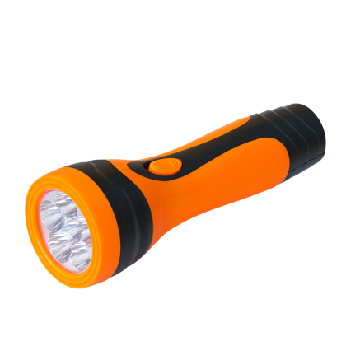
The business of the dark Market
Notes:
Cybercrime seen as a separate entity to traditional crime, but it is carried out by the same types of criminals for the same type of reasons:
Hackers are professional thieves, criminal gangs, disgruntled employees, professional competition, activists, disillusioned youth and state adversaries. Same motivations -- boredom and vandalism, ideological or political support, malice or revenge, terrorism or notoriety and sensationalism, mostly for monetary gain through extortion or sale of illegally obtained data. But there are some important differences:
SCALE: Attacks can be conducted on a scale not possible in the physical world. A traditional bank robber may only be able to hit one or two banks a week, a cyber-attack can target 100’s if not 1000’s of sites at once.
REACH: Attacks can be performed from anywhere in the world; they can be performed anonymously and within jurisdictions where the consequences of those actions may not, or cannot, be addressed by the criminal justice system. Attackers can extract far more data digitally than would ever be possible in the physical world. For example, One (1) gigabyte of data is approximately 4,500 paperback books. Think of how many gigabytes of data is held on a system, hackers can extract this within a matter of minutes.
SPEED: Attacks are conducted at machine speed; a criminal can write a piece of code that can target multiple sites in minutes.
PERCEPTION and MEDIA EFFECT: When large financial institutions have been hacked the media has often wholly apportioned blame to the organizations rather than the criminals. This would not be the case in a physical bank robbery. And in the case of ransomware, most victims will not come forward out of fear it will damage their brand and in more than half of the cases, pay ransom to keep it quiet.

Slide 5
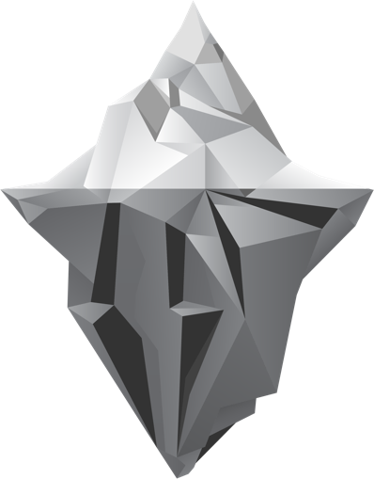
Beneath the Surface of the web
SURFACE WEB
Represents everything on the Internet indexed by search engines and is only a small portion of what is online.
1.5 billion URLs
DEEP WEB
Part of the Web not indexed by standard search engines and represents the bulk of the content online. Most of this content is innocuous.
Billions of sites behind firewalls, requiring credentials
INVISIBLE TO STANDARD SEARCH ENGINES
DARK WEB
A subset of the Deep Web, a.k.a. Dark Market. Only accessible with specific software, configurations, or authorization.
8,000 active links, a little over 100 markets
SPECIAL ACCESS REQUIRED
Notes:
Deep Web includes anything behind firewalls that might require a password, so if you imagine all the stuff behind corporate websites you can’t reach, or the files behind university servers—it’s a great deal of content, truly deep. And mostly innocuous.
The Dark web is a SUBSET of the Deep Web and includes those sites that operate through the encrypted TOR browsing network. Dark Web is smaller than most think,. To provide clarity on the Dark Web, Security researchers crawled some 260,000 onion pages to estimate the full reachable Tor network from a starting set of onion sites they pulled from public lists and internal content. They found 55,828 onion domains; of these, only 8,400 (15%) were live sites. Some change onion addresses every few hours.
These sites often require specific software, configurations, authorizations, account creations or invitations, often operating in a gray legal area or are selling illegal and nefarious goods and services. It includes:
anonymous marketplace (some of these marketplaces claim to have a million monthly visitors)
hacker forums,
Many sites designed to entice you into turning over precious cryptocurrency.
Sites which contain child pornography, torture videos and mythical red rooms that purport to display live murders.

Slide 6
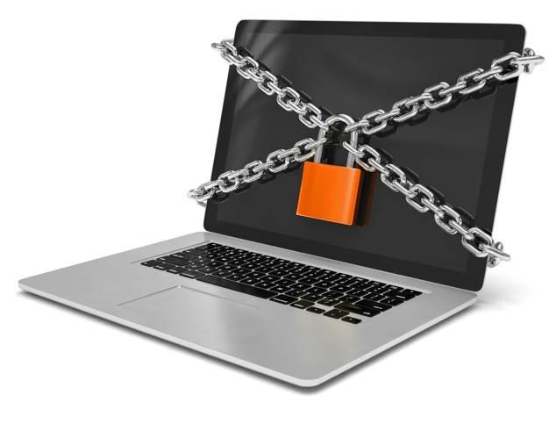
Why dark market threat intelligence?
Early detection of zero-day attacks, new exploits, and malware.
Identify sale of an organization’s stolen data, intellectual property.
Organizations can better protect themselves if they know hackers’ Tactics, Techniques and Procedures (TTPs).
Provides context for a complete security posture.
Notes:
If you are a bank executive, it would be wise to understand payment fraud; if you are a narcotics officers, it would be wise to understand digital distribution networks and the avenues by which criminals obtain guns; if you are a corporation that handles sensitive healthcare or financial data, you may want to understand how your data is being sold and distributed in order to convince executives to budget cybersecurity.
TACTICS
TECHNIQUES (types of malware, malicious domains, first-stage payload, etc.)
PROCEDURES (hackers’ MO)
THESE MARKETS SHOW THE DEPTH AND BREADTH OF THREATS AND HOW THEY MONOTIZE DATA
IT HELPS TO KNOW WHO THE LARGEST MOST LUCRATIVE TARGETS ARE (AND IF YOU”RE ONE OF THEM)
THREAT INTEL = BETTER RISK DECISIONS
MAY SPOT DATA or IP FOR SALE

Slide 7
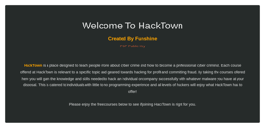
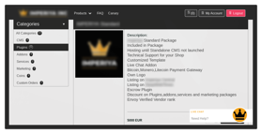
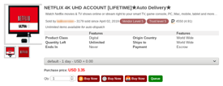
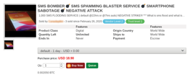
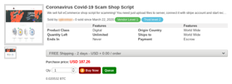
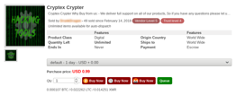
ANONYMOUS MARKETPLACES
TOR- and PGP- encrypted messaging and cryptocurrency
Trustless environments
Steady growth of vendors, 1 million users
Specialized markets for hacker exploits, compromised servers and computers (bots) for rent, cybercrime-as- a-service, and recreational and pharma drugs
Numerous COVID-19-specific marketplaces
Notes:
Silk Road 2011-2013: Bitcoin’s first proof of concept; Introduced cryptocurrency and changed our understanding of encryption
The Silk Road, Bitcoin’s first real world proof- of -concept hosted a trustless environment using PGP messaging and a bitcoin escrow service to broker deals between anonymous buyers and sellers. It became the model for every successful digital black market we have today; technical featured adopted by Alibaba the second largest online retailer to Amazon.
Hansa taken down in a Dutch raid, LE infiltrated the sight for months-few prosecutions of cybercriminals Alphay Bay, Apollon Market take downs and some major exit scams – some have folded with millions of dollars of cryptocurrency
New markets with most users: Empire Market with 100,000 users; White House Market, Yellow Brick Road; Regional and country-specific sites in US) Russia, Spain, EU and Australia URLs change often (hosted on bulletproof servers). TOR sites with specialized access provide constant updates of where to find them. Takes a noobs technical knowledge to access TOR, onion sites. With a basic understanding of cryptocurrency and PGP, anyone with a computer and an internet connection can access.
USPS has benefited from interstate traffic. Stealth shipping methods are an art and discussed at length on forums. Increased sale of packing material such as mylar and smell-proof plastic to avoid detection. (ULINE)
Ross Ubricht serving 2 life sentences plus 40 years for a non-violent crime, flawed case was unjust #freeross and freeross.org Law enforcement takedowns and exit scams are increasing, but there are still too many cybercriminals untouchable in foreign jurisdictions.
Most cybercriminals are rarely if ever caught. FBI C3 2018 report stated only 1% of cybercrimes are ever prosecuted. The Silk Road website was taken down in 2013 and replaced with another within 2 months. HANSA, Alphabay, Dream Market, Apollon, Empire Market and others followed and have all been taken down. Markets today look almost identical to the Silk Road in user experience and functionality.
WALL STREET MARKET shut down y LE May 2019; Apollon Market exit scammed in February 2020.
Vendors post $500 escrow and aren’t likely to stiff customers on $200 order.

Slide 8
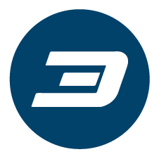
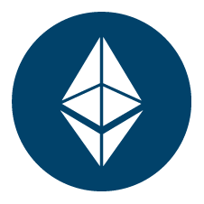
Cryptocurrency’s ROLE
Crypto was not made originally for cybercrime:
Benefits of crypto: discretion, accessibility, decentralized, and peer-to-peer focus.
Bitcoin’s value: network strength, ability to obscure payments, market cap of $175 billion.
$76 billion – 46% of Bitcoin transactions – involved in cybercrime annually.
Monero (XMR), DASH, and Zcash (ZEC) have greater anonymity features; $2.1 billion market cap.
Bitcoin
Dash
Ethereum
Monero
ZCash
Notes:
Was a reaction to government bailouts of banks and Wall Street in 2008.
Pseudo-anonymous and can be tumbled to further obfuscate any money trail.
Isn’t controlled by any nation state or federal banking system and not easily subject to seizure.
Provides a faster and less expensive way to send transactions worldwide.
Is accepted on black markets for physical good and services where other money can not and where credit cards are unfeasible.
The street figured out its feasibility before the banks did.
Without cryptocurrencies, however, the black markets for cybercrime would not function as easily or grow as quickly. Despite government efforts to curtail or even stop the use of cryptocurrency, there is almost nothing they can do to keep people from participating in the digital ecosystems they create.
(1) University of Sydney study about 46% of transactions on the Bitcoin blockchain, about $76 Billion, can be traced to cybercrime. Steadily declining over the last 6 years as more investors and crypto projects participate in the Bitcoin ecosystem.
4,914 cryptocurrencies *—and some like Monero ($1 Billion Marketcap), Dash and ZCash have anonymity and privacy features beyond those found in Bitcoin. The total worldwide market value of cryptocurrencies stands at $197.5 Billion ($58 Billion 24-hr volume), so there is clearly a growing market. Ultimately these markets exist because of the people who participate in their ecosystems. They trust the code, so they don’t have to trust each other.

Slide 9
Dark Web Goods for sale
Fullz: slang for "full information." A complete set of information of a possible victim used to commit fraud.
BUSSINESS FULLZ
Business' bank account number Employee Identification Number (EIN) Certificate of Business Corporate Officers’ Names Birth Dates Social Security Number
PERSONAL FULLZ
Personal Identifiable Information (PII) such as: Bank Account Information Credit Report Driver’s License Numbers Utility Bills Social Security Number Proof of Insurance

Slide 10
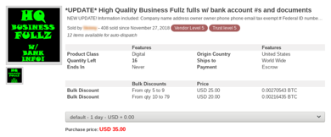
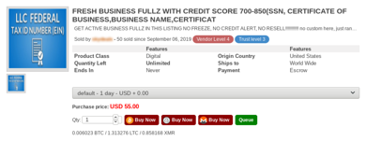
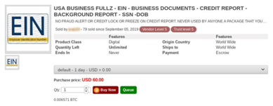
SALE OF Dark Market GOODS
Business Fullz – Costs $35-$60 per piece
Financial Loan Applications
Personal Health Information (PHI)
According to the ID Theft Resource Center, over 163.5 million individuals were affected by 540 data breaches between Jan. 1 and June 30 of 2020.
Notes:
BUSINESS FULLZ DATA
An alarming new finding by the TRU team was hackers, not only selling complete personal identity kits, a.k.a fullz (contains all the info a criminal needs to steal someone’s identity including), but
we saw threat actors selling Full Business Identity Kits. (a.k.a. BUSINESS FULLZ) These include everything a scammer needs to impersonate a corporate officer of a business. including. Bank
Acct Numbers, Employee Identification Number (EIN), Certificate of Business, Corporate Officers’ Names, Birth Date, SSN.) . These BUSINESS FULLZ cost between $35 -$60, depending on the
location of the business.—the country it is in.
What a Criminal Can do With Business Fullz’—Pull off many financial schemes including:
Apply for Business Loans and Lines of Credit
Take Out High-Limit Credit Cards
Set up business bank accounts to launder large sums of money
Launch Business Email Compromise attacks against victim company’s customers
Stolen Financial Loan Applications Produce Personal FULLZ —Contains Loan Applicant’s Personal Identifiable Information (PII) and Financial Information such as employment and income information, bank account information, bank statements, credit report, SSN, driver’s license or passport (some form of government issued photo ID), utility bills, lease agreements, and proof of insurance.
Used by criminals to steal someone’s identity, withdraw money from the identity victim’s bank account, use the identity victim’s credit cards, apply for new credit cards in the victim’s name, apply for personal loans in the victim’s name, buy an expensive car. These fullz are being sold for $50 and $75 a piece.
BANK, CCs, DOB, SS, PHONE, ADDRESS, MOTHER MAIDEN) DARK MARKET SALE PRICES OF FULLZ:
Credit and Gift Cards are still popular commodities, auto-carding shops on markets allow buyers to check balances.
Billions of records exchange hands on dark markets. Your information is out there, not if but when it will be used.
July 2019 data leak at First American Financial Corp., the largest real estate title insurance company in the U.S., exposed transaction records of 885 million individuals. According to Brian Krebs, American journalist and investigative reporter, First American leaked hundreds of millions of documents related to mortgage deals going back to 2003. Capital One breach by a former AWS employee exposed credit information on 100 million people. Microsoft exposed 250million records due to a misconfiguration of a customer support database.

Slide 11
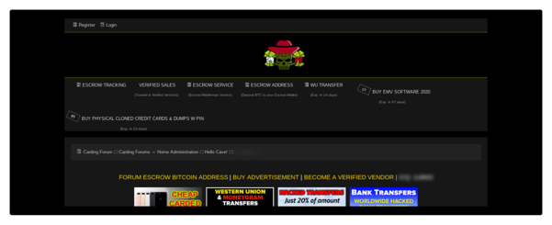
CREDIT CARDS, MONEY LAUNDERING & FINANCIAL Fraud
Bank Transfers and Money Laundering – Charging 10 cents to 12 cents for every $1 wired to a bank account.
Cloned ATM/Debit Cards or Credit Cards with PIN – Costs between 10% and 15% of bank or credit card balance.
Hacking Private Information – Through shell corporations, sole proprietorship papers, applications for small business loans.
Notes:
TOOLS FOR MONEY LAUNDERING AND FINACIAL FRAUD
Bank Transfers
Cybercriminals offering to sell cold, hard cash for a mere 10 cents to 12 cents on the dollar. Now, a year later, money laundering advertised on the underground markets as “Transfers” seems to be more popular than ever. The prices continue to remain approximately the same, 10 cents to 12 cents on the dollar. All a buyer has to do is provide the seller with a bank account or a PayPal account in which to transfer the money. If the buyer prefers, they can also pick up the cash at a Western Union location. This scheme is convenient for the buyer and the seller. The buyer does not have to have advanced computer skills, and they don’t have to know how to transfer funds from one bank account to another, how to get around the bank’s fraud alerts, or how to disguise the location of the computer they are using.
For the seller, because they do not ultimately receive the stolen funds, the risk to them is greatly reduced. Plus, they do not have to manage a network of money mules. Money mules are persons who have a bank account or multiple bank accounts and who knowingly, or unknowingly, permit cybercriminals to transfer stolen funds into their bank account so it can later be withdrawn. The cybercriminal pays the mule a portion of the siphoned-off funds. A well-established money mule, with a solid reputation and one who has multiple accounts in various top financial institutions, will command approximately 10% of the take. However, the payout can run up to 20% depending on the risk and the amount being stolen. Also, the hacker has to trust that the mule is going to remit the remainder of the stolen monies to them after the mule has taken their cut. It is for this reason that the threat actor will seek out a mule or a mule network operator with a solid reputation. They may pay a higher percentage, but it is critical to work with a mule that has established bank accounts and can be trusted to remit the funds. Experienced hackers will always use mules when stealing money from a bank account. This way, if law enforcement discovers the theft in its early stages, it is the money mule who will get caught holding the bag.
VALUABLE HACKER GUIDES: FOUR-STEP PROCESS FOR CASHING OUT, KNOW VULNERABILITIES IN THE CHAIN
Cloned Credit & ATM/Debit Cards — continue to be a Hot Commodity popular. Easier to monetize, but more risky to monetize unless you get mules to pull money out of ATM.
Credit Card Credentials — Scammers use them to purchase high-end items online, ship to a mule, then sell the goods for ..75 to .50 cents on the dollar.
Selling customers’ pizza points, credentials to Disney Plus, NetFlix and Spotify accounts.

Slide 12
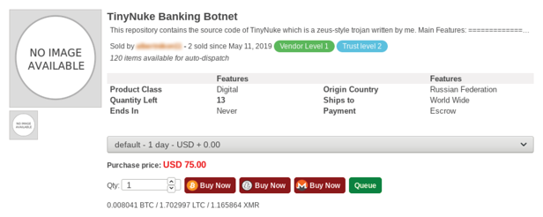
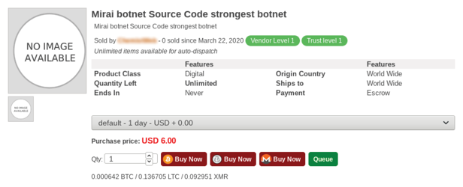
EXPLOITS, compromised SERVERS & Hijacked computers (BOTNETS)
Compromised public cloud servers on AWS, Azure, and GCP.
Trojans and Malware downloaders.
Exploit Kits Rent for $800-$2,000 a month.
Individual exploits sell for $80 to $1,000 depending on systems successfully exploited.
Remote Administrative Tools (RATs) offered for as much as $500, while others can run between $1 to $12.

Slide 13
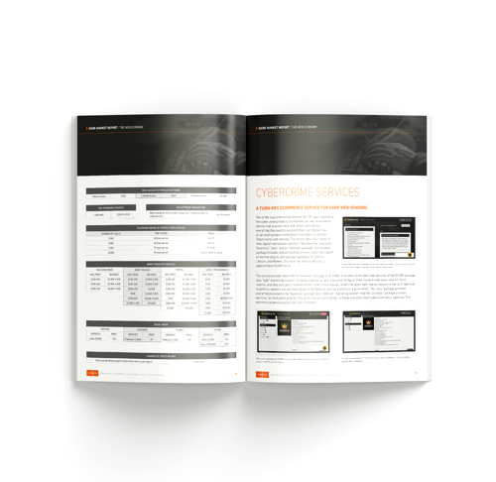
Cybercrime- as-a-service
Notes:
Cybercrime-as-a-service continues to be a popular trend, making it darn easy for novice cybercriminals to get into cybercrime.
This is the offer of services and tools that are being sold to make cybercrime easier for novice, noob or script kiddie users.

Slide 14
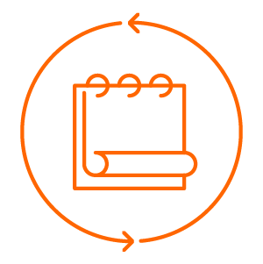
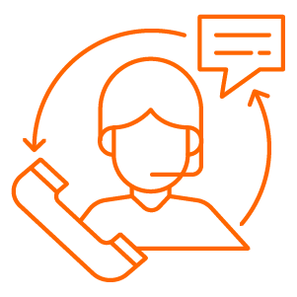
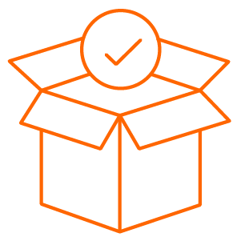
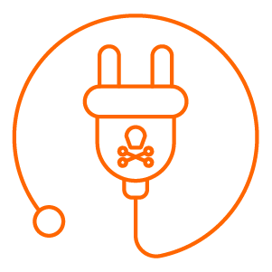
How it works
Affiliate programs and subscription models.
Customer service including live chat, video tutorials, and customer service.
Ready-to-access servers, via stolen Remote Desktop Protocol credentials, are sold for servers in any country.
Plug-n-play ransomware campaigns need little more than a secure email address, but ransomware affiliate programs are more popular.
Notes:
Affiliate programs and subscription models to cybercrime schemes, e.g. ransomware; bank attacks via banking trojans recruit money mules, web inject authors, botnet owners, etc.
Customer service: live charts, video tutorials
Dark Markets selling access to botnets for rent, access to corporate servers via stolen RDP credentials (currently $16 to $25 a piece). Hackers selling RDP creds for servers any almost any country.
RaaS---not as popular now, the Ransomware affiliate programs are much more popular…where various threat actors are recruited for key roles in the operation, exa. Botnet owner/operators; coders, scammers owning email lists, etc.

Slide 15
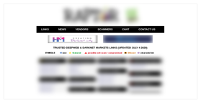
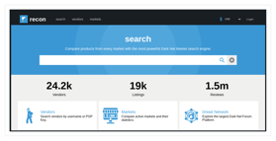
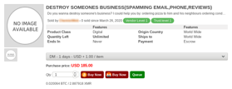
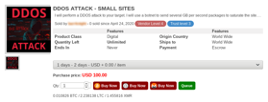
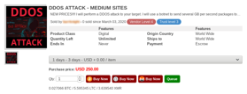
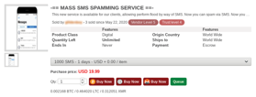
Cybercrime offerings
Organized criminal groups and hackers make it easier to do business.
Recruit on underground forums for specific criminal roles.
Destroy a Target Business for $185.
Distributed Denial of Service (DDoS) attack for small-to-medium website; $100-$250/day, $479-$659/week, or $2,000/month.
Email Spamming at $32 for 20,000 or $54 for 50,000 messages.
SMS Spamming at $19.99 for 1,000 SMS.
Specialized site for hiring hackers.
Notes:
Organized Criminal Groups and Hackers Make it Easier to Do Business
Recruit on underground forums for specific criminal roles. Offer escrow to administrators to ensure payment.
Destroy a Target Business $185 (using spam emails, phone calls, shipping unwanted items to business, & include business phone nu. in adverts).
Distributed Denial of Services (DDoS) $100--$250/day (small to medium websites), $479-659/week or $2000/month.
Email Spamming $32 for 20,000 or $54 for 50,000 messages.
SMS Spamming $19.99 for 1,000 SMS
Specialized site for hiring hackers.

Slide 16
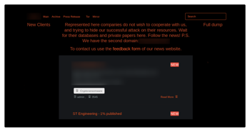
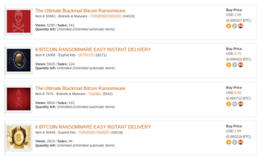
Ransomware Revolution
Criminal organizations: Sodin, Maze, Nemty, Dopplepaymer exfiltrating data.
Pay Up or Get Your Data Published on the Web.
Sodin announced move to Monero.
Low cost, high reward; rarely arrested or prosecuted.
Rarely reported, often paid ransom; cybersecurity insurance industry pays.
Notes:
May 7, 2019 attack on City of Baltimore. Armor’s TRU Team identified the Twitter account taunting the mayor and city officials, following clues (such as bitcoin address traffic and C2 messaging) to determine legitimacy (Robbinhood was the strain, used only once before in Greensboro, NC in April). It was the name used on the account.
2019 year of ransomware evolution. In 2018 SamSam was joined by another highly active targeted operation (Ryuk), while 2019 saw the arrival of several new groups who have been linked to a series of highly disruptive attacks in the U.S. and Europe. The number of ransomware families being used in targeted attacks has multiplied in recent months. There are many different families being used in an exclusively targeted fashion: SamSam, Ryuk, GoGalocker, MegaCortex, Maze, Sodinokibi and RobbinHood. Dopplepaymer, CovidLocker.
Security staffing firm Allied Universal was the first organization to experience this additional form of extortion. The ransomware attackers demanded $3.8 million after Allied missed two payment
deadlines. The threat actors did release some of Allied’s dataon the internet and threatened to give all of it to WikiLeaks.
By May 2020, a ransomware attack using this approach had asked a record $42 million ransom payment from celebrity law firm Grubman Shire Meiselas & Sacks. There have been no public reports about whether or not the law firm paid a ransom. The threat actors behind the attack, called Sodin, reaported holding thousands of the law firm’s documents hostage—allegedly including private information on Lady Gaga, Madonna, Nicki Minaj, Bruce Springsteen, Mary J. Blige, Christina Aguilera, and Mariah Carey. The digital kidnappers increased their demand for payment to $42 million, double their initial $21 million ask, when the firm failed to respond. The group threatened to publicly release more data if they were not paid within a week. On July 10, the ransomware gang kicked off an auction site with items being sold through July 18, purportedly containing data of their clients Bruce Springsteen, Usher, Nicki Minaj, Mariah Carey, Jessica
Simpson, and LeBron James with a “buy now price for $1.5 million for each cache.

Slide 17
COVID-19: Supplies, DRUGS, Test KITS
Chloroquine and Hydroxychloroquine advertised as early as March 2020 as a purported treatment for COVID-19.
Face masks, respirators, protective gear sold for 100% to 500% markup.
COVID-19 testing kits.
Coronavirus deals on recreational drugs.
Social engineering campaign tools created using COVID-19 infection maps and WHO spam email.
Notes:
While the legitimate businesses, world leaders and healthcare community are focused on the health and economic effects posed by COVID-19, cybercriminals around the world have been trying to capitalize on this crisis. In Marcch, TRU began seeing the following being hawked in the underground markets.
Chloroquine and Hydroxychloroquine were immediately being sold once these purported treatments hit the news.
Face masks, respirators, protective gear sold for 100 to 500% markup.
Testing kits.
Dark Market Vendors promote Coronavirus deals on recreational drugs and are generally bullish on business.
Social Engineering campaign tools using COVID-19 infection maps and WHO spam email.
Please be more vigilant and cautious when opening links, emails or documents related to the subject COVID-19.
Organizations should ensure their detection and alerting capabilities are functional ,while protecting against the vulns introduced by having many remote workers

Slide 18
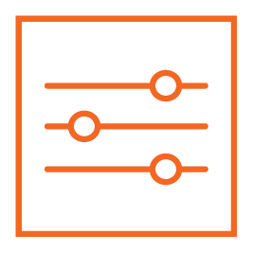
Industry survey on SECURITY & COMPLIANCE CHALLENGES: COVID-19
SURVEY PARAMETERS
IDG & CSO Magazine conducted survey.
Surveyed 150 security leaders.
87% senior execs, average company size of 24,000.
Published April 1, 2020.
ATTACKS ARE INCREASING
26% are seeing increased attacks.
73% believe that the impact of this pandemic will alter the way their business evaluates risk for at least the next five years.
WFH IS A NEW CHALLENGE
61% were more concerned about security risks targeting work-from-home employees.
22% are evaluating new security solutions/services to address the new work dynamic.
Notes:
Lets talk about the potential vulnerabilities of the largest distributed workforce in history. COVID-19 will change the way we work and how we remain secure.
One April 2020 CSO Mag. survey of security and IT leaders sheds light on how organizations across industries are dealing with the COVID-19 crisis, how prepared they were, how vulnerable they are, and what the long-term impact may be.
26% are seeing increased attacks in the volume, severity, and/or scope of cyber attacks since March 12th

Slide 19
KEY Takeaways and findings
Cybercriminals make substantial money from the sale of financial, PPI, and PHI data.
Hacker tools and services are readily available.
It does not take expertise to commit cybercrime.
Cybercriminals have taken advantage of the COVID-19 pandemic.
Threat intelligence is critical for businesses to protect themselves.

Slide 20
constant vigilance
Notes:
Because we know there is a growing, inexpensive and readily available market for hacker tools and services, what should be our call to action?
What tips can we provide security teams and IT professionals who want to be proactive?

Slide 21
Tips for your security/it teams
1 | Continuous cybersecurity awareness training.
5 | Monitor usage across your hybrid cloud environment.
2 | Find, classify, and protect your most sensitive data.
6 | Utilize cybersecurity technologies with defense-in-depth.
3 | Apply patches and updates regularly.
7 | Practice least privilege access control.
4 | Encrypt your data at rest and in motion.
8 | Implement an offline backup storage strategy.
Notes:
Train your people
Classify your data, what’s most important< senative< critical
Patch your stuff
Data encryption
Monitor cloud usage, security and data applications you migrate
Firewalls< anitimalware <intrusion detection: ids, fim, vs, av/am
2fa, multifactor authentication
Offline backup storage, store 3 copies on 2 different media and ensure 1 offsite

Slide 22
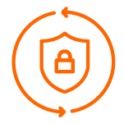
Armor’s security operations center
Data-focused, cloud-agnostic protection
24/7/365 detection and response against threats to your environment
+25,000 security incidents managed yearly
A FEW WAYS WE HELP
LATEST THREAT INTELLIGENCE Proactive, not reactive. Armor’s Threat Resistant Unit and third-party threat feeds are used. Robust threat detection & RESPONSE Armor's average dwell time is 1 day compared to an industry average of 78 days. SELF-LEARNING Armor utilizes automation and orchestration technologies to enhance the effectiveness of our response.
Notes:
24/7/365 SOC to detect and respond to threats.
As your company scales, or if your company is a financial services, healthcare or SaaS provider, the need for a Security Operations Center of SOC is growing. Armor offers cloud security resources for a fraction of the cost of doing it yourself and we are experts in compliance frameworks such as HIPAA, HITRUST CSF, PCI DSS, and GDPR.
At Armor we monitor over 200 million events per day; doesn’t necessarily correlate to actual incidents or breaches.

Slide 23
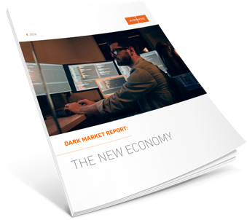
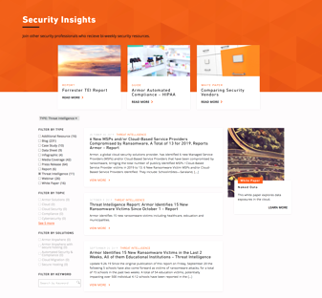
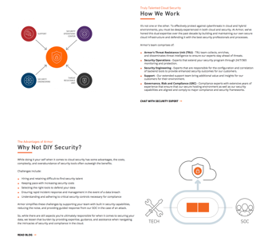
resources
THE 2020 DARK MARKET REPORT
armor.com/resources/the-dark-market-report/
ARMOR THREAT REPORTS
https://www.armor.com/resources/?fwp_resource_type=report
ARMOR’S SECURITY OPERATIONS CENTER
armor.com/extend-security-team/
Notes:
And look for Armor Threat Intelligence Reports about news on threats OR Learn about our Security Operations Center and how you can extend your security team.
To close, a few of my personal comments and tips, and let me say again, don’t try this at home.
Visiting the dark corners of the web is not recommended for anyone who isn’t fully protected from hackers.
Anyone curious about visiting black markets through TOR alone should stop themselves and consider the source. You can get into a lot of trouble, even just by viewing content, let alone buying a bag of weed from someone and committing federal mail fraud.
And check out HaveIBeenPwnd to see if your email credentials have been leaked to the dark army.
My best tip for anyone is Change your passwords often and use a password manager that can generate complex passwords for all your accounts.

Slide 24
THANK YOU.
WWW.ARMOR.COM

